Slide 1
Tutorial : EC reanalysis and CAPT data processing
Peng-Jen Chen
Notes:
The Cloud-Associated Parameterizations Testbed (CAPT)

Slide 2
Preparation
H2o account :gcc10@140.112.50.233
Create a folder under your home
Cp the all files in /work2/C.jerryjerry9/2019_summer/tutorial/hindcast_class/*

Slide 3
Introduction
Forecast Hindcast
Climate model in hindcast mode
improvement of the errors in the hindcast mode
improvement of the errors in the climate mode
Climate models with better forecast skills perform well in the climate simulations.
Notes:
Assuming that improvement of the errors in the hindcast mode is very relevant to the improvement of the errors in the climate mode.
many of the major systematic biases in the climate simulations are associated with ‘‘fast processes’’ (e.g., clouds and precipitation).

Slide 4
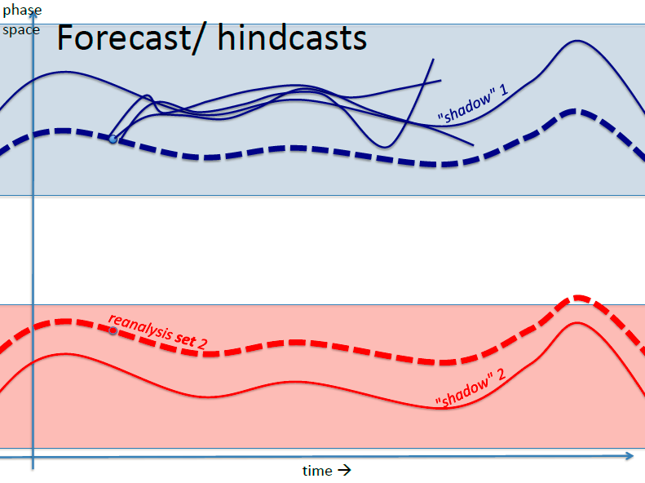
Why Hindcast Approach?
Time scale of days
B. Mapes @ CESM Workshop 2013
Allow to evaluate the nature of model parameterization (diabatic processes) errors before longer-time scale feedbacks develop

Slide 5
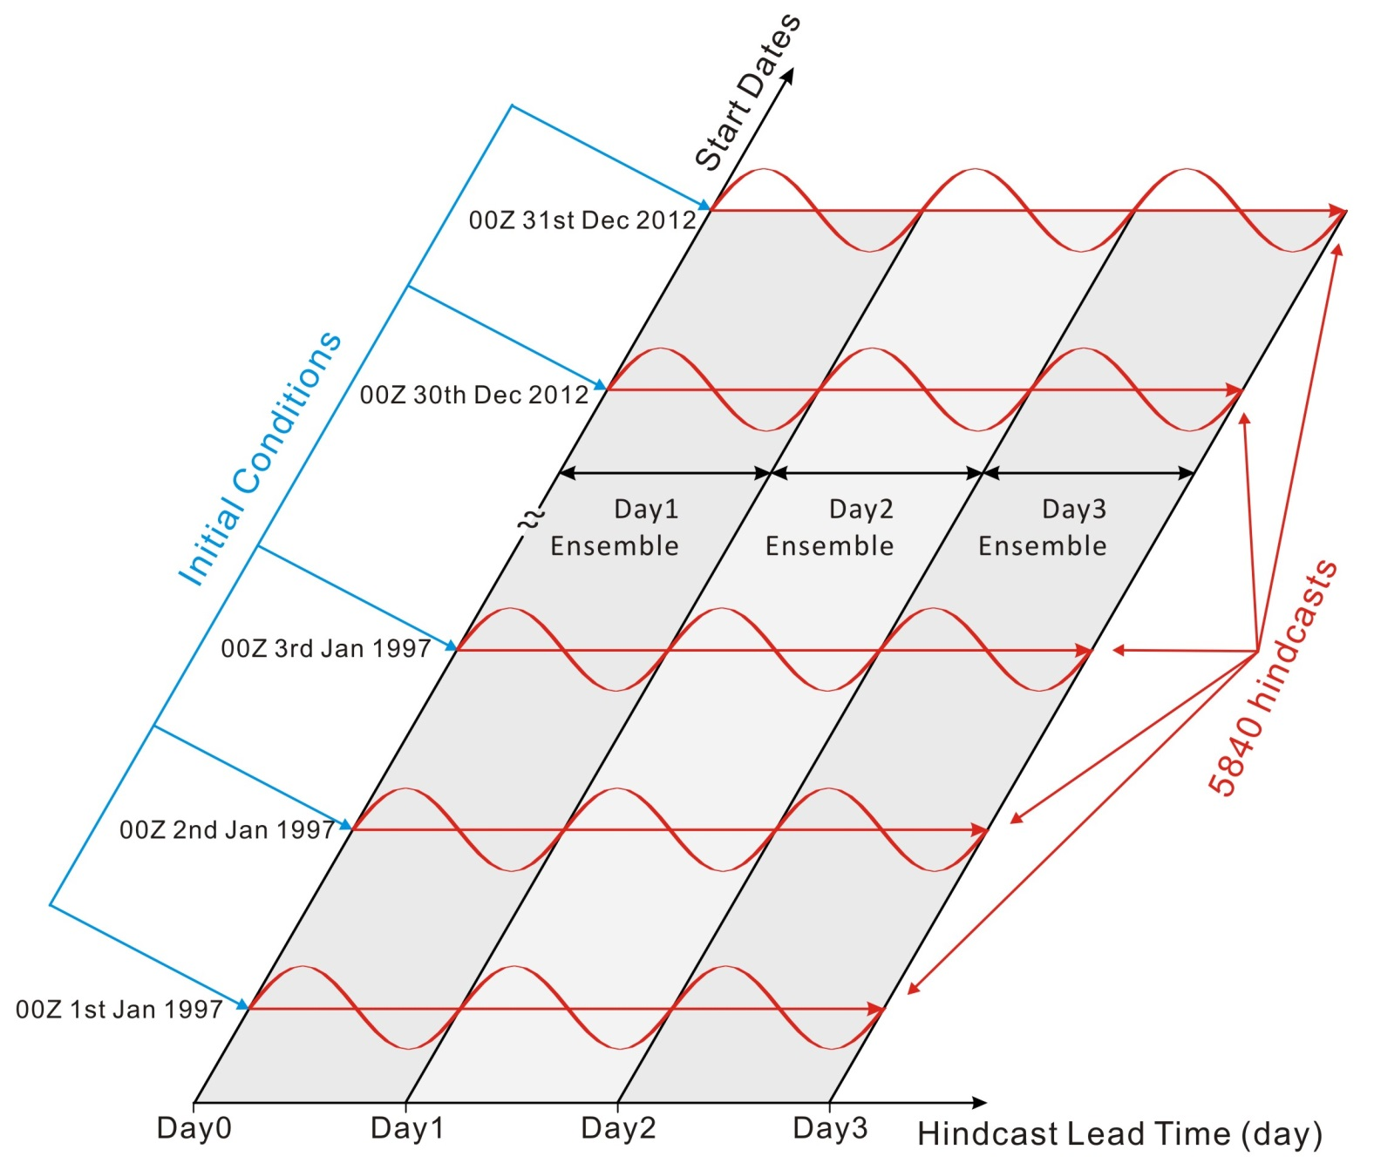
Identifying model biases caused by fast processes: The Multi-Year Hindcast Procedure
Day2
Day3
To compare model simulations (particular moist processes) to long‐term observations
To establish robust model systematic biases and identify possible causes.
To diagnose how interactions of fast physics (within 3 days) depend upon the imposed large-­scale state
Ma et al. JAMES (2013; 2015) (a.k.a TransposAMIP)

Slide 6
The Cloud-Associated Parameterizations Testbed (CAPT) Hindcast Experiment Design
3-day long hindcast simulations starting every day at 00Z for the period of 1998 – 2012
CAM5.1/CLM4.0 (~ 1 x 1 degree and 30 vert. levels)
Atmospheric initial state variables are from ERA-Interim and other atmospheric variables are from a nudging run
Land initial conditions are from an offline land simulation forced with atmospheric reanalysis and observations
Ma et al. JAMES (2015)

Slide 7
Introduction
The Cloud-Associated Parameterizations Testbed
Model : CAM5
Initial data : ERA-interim Reanalysis
Hindcast 3 days
e.g. Using 2003/05/12 as initial data to forecast 2003/5/15’s weather.
Comparing with the 2003/05/15’s EAR-interim Reanalysis
Notes:
ERA-Interim Reanalysis (Dee et al.
2011) for the atmospheric initial states.
Without a data assimilation system, we applied
a two-step process (See figure to the right)
to obtain other necessary variables to
initialize both the atmospheric (e.g.,
aerosols and clouds) and land models (e.g.,
soil moisture). First, we nudged only the
model horizontal velocities towards ERAInterim
Reanalysis values, given a 6-hour
relaxation time scale, to obtain all necessary
variables. Second, we obtain land initial
conditions from an offline CLM simulation
forced with observed precipitation, winds, and
surface fluxes. The nudging and hindcast
simulations were prescribed with NOAA Optimum
Interpolation weekly SSTs and sea ice
(Reynolds et al. 2002). The offline CLM
simulation was forced with observed six-hourly
atmospheric precipitation, winds and surface
fluxes from N. Viovy (unpublished data, 2013)
available at

Slide 8
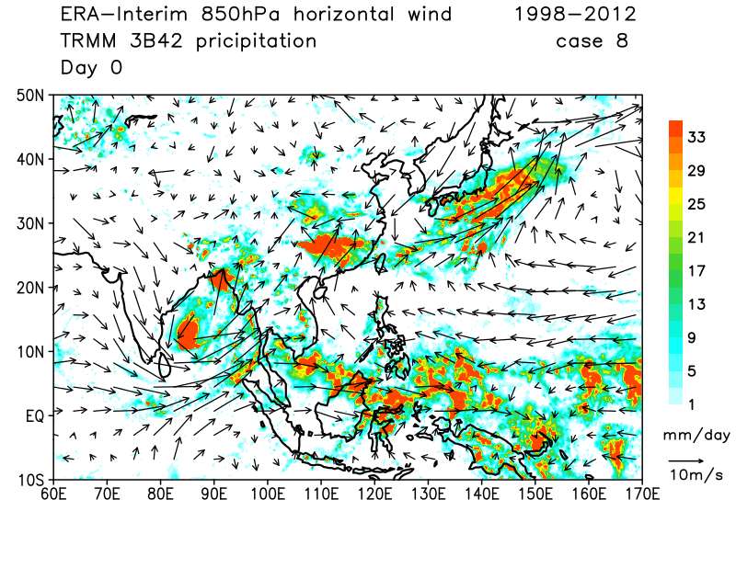
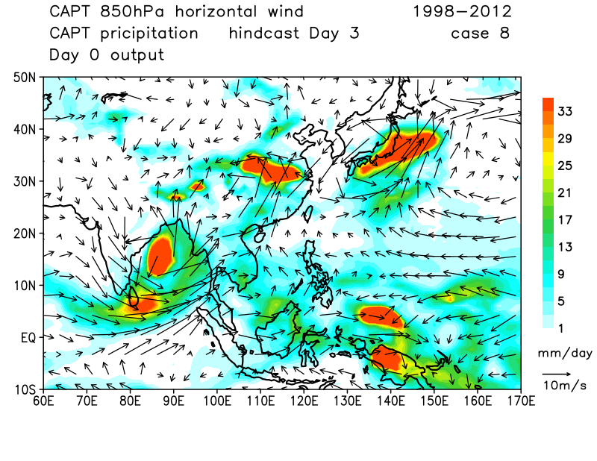
Introduction – specific case
Notes:
These metrics and diagnostics should provide an objective measure to quantify how fast hindcast errors approach climate errors and to judge the improvement of model simulations from new parameterizations. This is under the premise that improvement of these errors in the hindcast mode is very relevant to the improvement of these errors in the climate mode. Indeed, climate models with better forecast skills tend to perform well in the climate simulations (Hurrell et al. 2010; Martin et al. 2010) since many of the major systematic biases in the climate simulations are associated with ‘‘fast processes’’ (e.g., clouds and precipitation). Furthermore, a standard set of metrics and diagnostics for climate model forecasts is particularly needed because more and more major modeling centers are adapting the concept of ‘‘seamless prediction’’ across weather and climate time scales in developing their future weather forecast models and climate models (Palmer et al. 2008).

Slide 9
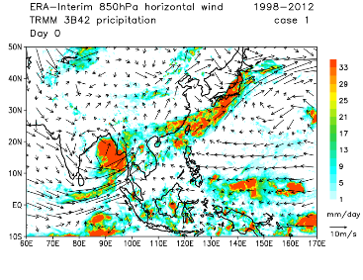
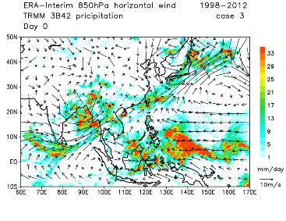
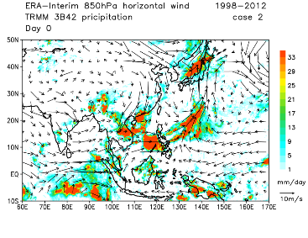
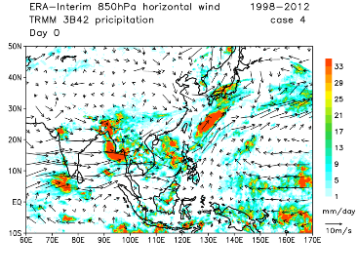
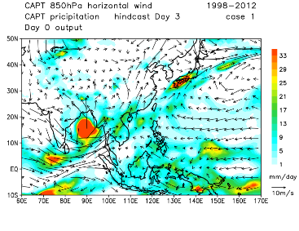
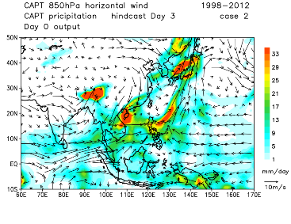
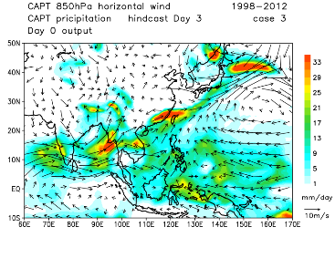
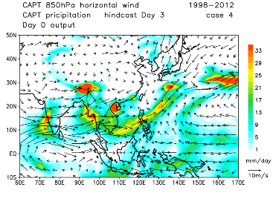
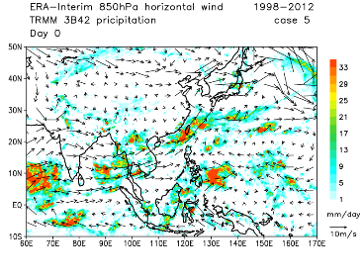
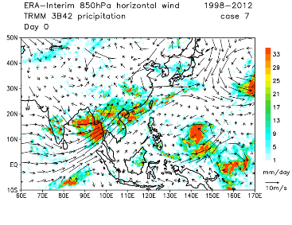

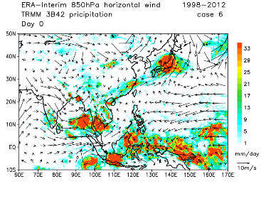
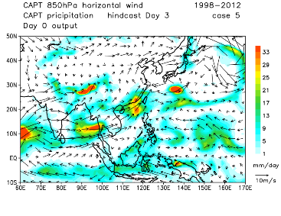
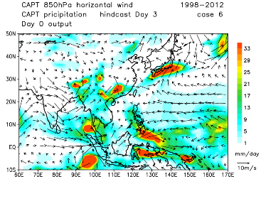
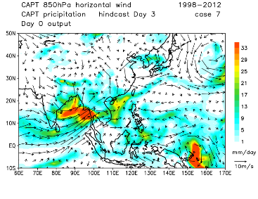

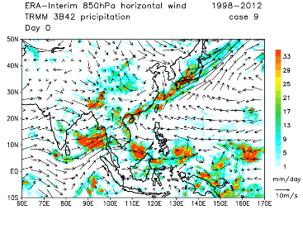
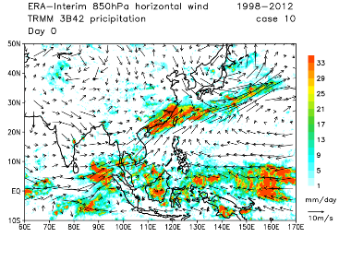
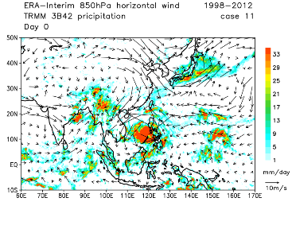
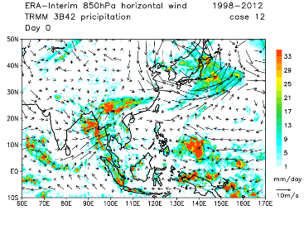
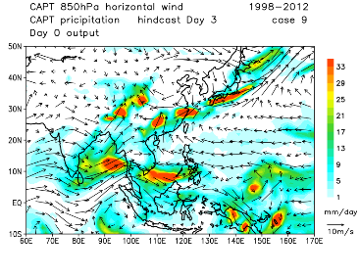
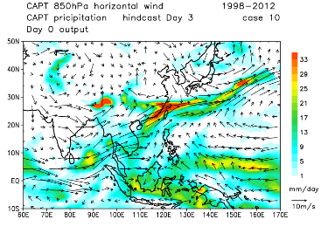
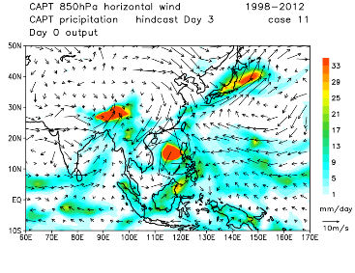
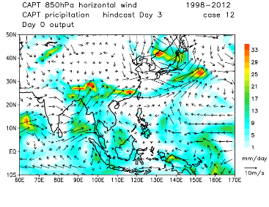
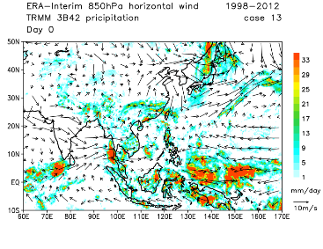
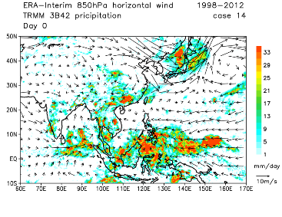
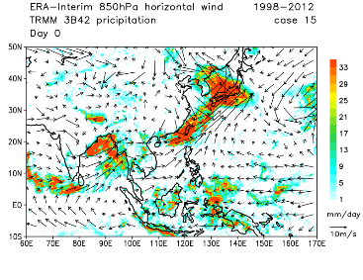
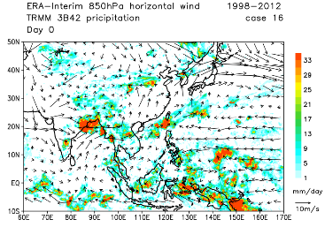
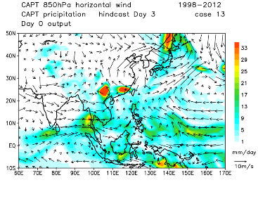
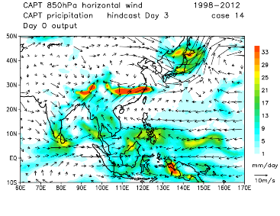
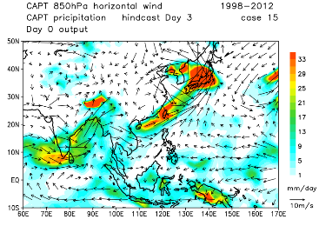
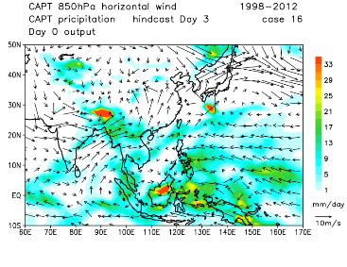
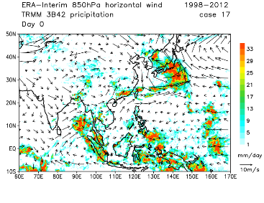
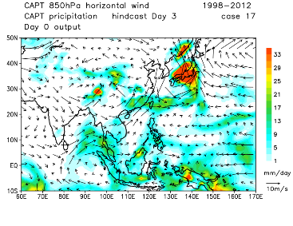
Introduction – cases analysis
Notes:
These metrics and diagnostics should provide an objective measure to quantify how fast hindcast errors approach climate errors and to judge the improvement of model simulations from new parameterizations. This is under the premise that improvement of these errors in the hindcast mode is very relevant to the improvement of these errors in the climate mode. Indeed, climate models with better forecast skills tend to perform well in the climate simulations (Hurrell et al. 2010; Martin et al. 2010) since many of the major systematic biases in the climate simulations are associated with ‘‘fast processes’’ (e.g., clouds and precipitation). Furthermore, a standard set of metrics and diagnostics for climate model forecasts is particularly needed because more and more major modeling centers are adapting the concept of ‘‘seamless prediction’’ across weather and climate time scales in developing their future weather forecast models and climate models (Palmer et al. 2008).

Slide 10
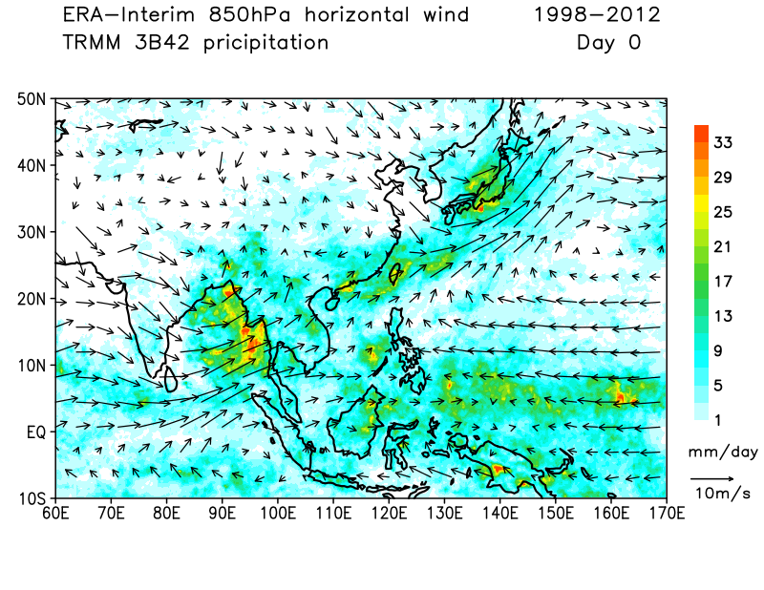
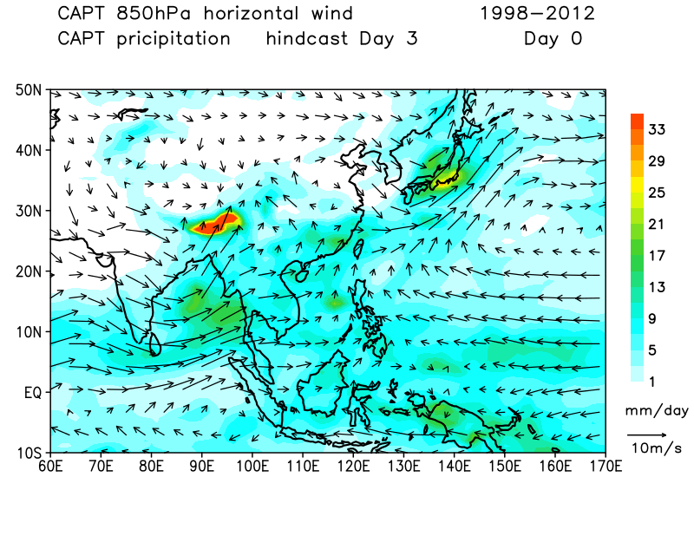
Introduction – composite analysis
Notes:
These metrics and diagnostics should provide an objective measure to quantify how fast hindcast errors approach climate errors and to judge the improvement of model simulations from new parameterizations. This is under the premise that improvement of these errors in the hindcast mode is very relevant to the improvement of these errors in the climate mode. Indeed, climate models with better forecast skills tend to perform well in the climate simulations (Hurrell et al. 2010; Martin et al. 2010) since many of the major systematic biases in the climate simulations are associated with ‘‘fast processes’’ (e.g., clouds and precipitation). Furthermore, a standard set of metrics and diagnostics for climate model forecasts is particularly needed because more and more major modeling centers are adapting the concept of ‘‘seamless prediction’’ across weather and climate time scales in developing their future weather forecast models and climate models (Palmer et al. 2008).

Slide 11
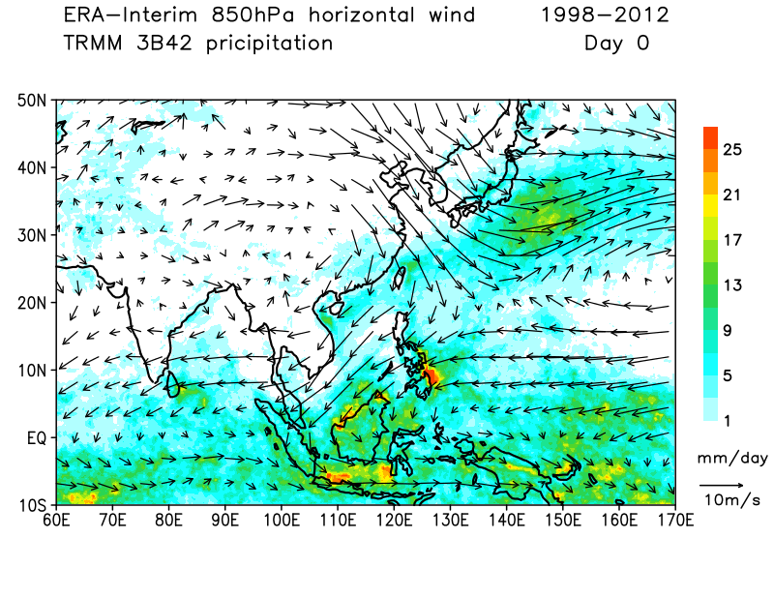
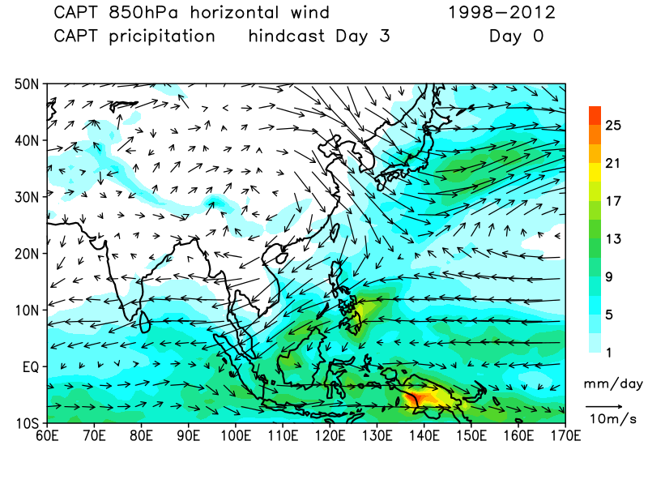
Introduction – cold surge cases
Lots of date
2001-12-23
2003-01-28
2004-01-20
2004-01-27
2005-01-15
2005-02-01
2005-02-19
2005-03-04
2005-03-12
2005-12-21
2006-01-06
2007-01-28
2007-02-01
2008-02-09
2008-02-11
2009-01-09
2009-01-13
2009-01-24
2009-12-20
2010-01-12
2010-02-18
Data from original data
Matlab, NCL,
GrADS…
Spatial Area
Time period
Variables

Slide 12
Introduction – cold surge cases
Lots of date
2001-12-23
2003-01-28
2004-01-20
2004-01-27
2005-01-15
2005-02-01
2005-02-19
2005-03-04
2005-03-12
2005-12-21
2006-01-06
2007-01-28
2007-02-01
2008-02-09
2008-02-11
2009-01-09
2009-01-13
2009-01-24
2009-12-20
2010-01-12
2010-02-18
Data from original data
Matlab, NCL,
GrADS…
Spatial Area
Time period
Variables

Slide 13
Data processing
ERA-interim (daily) & TRMM (3 hourly)
Spatial Area : Latitude range, Longitude range
Time period : Cold surge cases, Time evolution (e.g. first day of cold surge as day zero)
Variables : U, V, W, Q, T, RH, Divergence
CAPT-day-3 (daily)
Time period : Cold surge cases, Time evolution
Variables : (check daily_var_h1.txt and daily_var_h1.txt)
Notes:
舉例而言 寒潮達標的第一天當作day 0 來看前後幾天,整個天氣的變化情形

Slide 14
Data processing
ERA-interim & TRMM
input.sh
ecreadfile_crossyear.sh & trmmreadfile_crossyear.sh
setctl.sh & trmmsetctl.sh
example_trmm.ctl & example_ec.ctl
forfirstline.txt
Notes:
舉例而言 寒潮達標的第一天當作day 0 來看前後幾天,整個天氣的變化情形

Slide 15
Data processing
ERA-interim & TRMM
Create “.ctl”
GrADS draw figure
Date 們.txt
Input.sh
setctl.sh
Datefile.txt contain :
1.Spatial Area
2.Time period
readfile.sh
.nc files: contain variables
Matlab or NCL draw figure
Notes:
舉例而言 寒潮達標的第一天當作day 0 來看前後幾天,整個天氣的變化情形

Slide 16
Pre work 1.copy hindcast folder 2.write a [Datefile].txt (see the example_date.txt)
[Datefile].txt
1998-05-18
1998-05-24
1999-05-27
2000-05-19
2001-05-19
2002-05-10
2002-05-16
2003-05-15
2004-05-13
2005-05-09
[inputfile].txt
1 for inputfile (this line is from forfirstline.txt)
1998-05-15 1998-05-21 lat -10 60 lon 60 170 end
1998-05-21 1998-05-27 lat -10 60 lon 60 170 end
1999-05-24 1999-05-30 lat -10 60 lon 60 170 end
2000-05-16 2000-05-22 lat -10 60 lon 60 170 end
2001-05-16 2001-05-22 lat -10 60 lon 60 170 end
2002-05-07 2002-05-13 lat -10 60 lon 60 170 end
2002-05-13 2002-05-19 lat -10 60 lon 60 170 end
2003-05-12 2003-05-18 lat -10 60 lon 60 170 end
2004-05-10 2004-05-16 lat -10 60 lon 60 170 end
2005-05-06 2005-05-12 lat -10 60 lon 60 170 end
Input.sh
[datefile].txt
Latitude range
Longitude range
Time range (unit: day)
[inputfile].txt (命名)
In:
[datefile].txt
forfirstline.txt
out:
[inputfile].txt

Slide 17
Pre work 1.copy hindcast folder 2.write a [Datefile].txt (see the example_date.txt)
[Datefile].txt
1998-05-18
1998-05-24
1999-05-27
2000-05-19
2001-05-19
2002-05-10
2002-05-16
2003-05-15
2004-05-13
2005-05-09
[inputfile].txt
1 for inputfile (this line is from forfirstline.txt)
1998-05-15 1998-05-21 lat -10 60 lon 60 170 end
1998-05-21 1998-05-27 lat -10 60 lon 60 170 end
1999-05-24 1999-05-30 lat -10 60 lon 60 170 end
2000-05-16 2000-05-22 lat -10 60 lon 60 170 end
2001-05-16 2001-05-22 lat -10 60 lon 60 170 end
2002-05-07 2002-05-13 lat -10 60 lon 60 170 end
2002-05-13 2002-05-19 lat -10 60 lon 60 170 end
2003-05-12 2003-05-18 lat -10 60 lon 60 170 end
2004-05-10 2004-05-16 lat -10 60 lon 60 170 end
2005-05-06 2005-05-12 lat -10 60 lon 60 170 end
Input.sh
[datefile].txt
Latitude range
Longitude range
Time range (unit: day)
[inputfile].txt (命名)
In:
[datefile].txt
forfirstline.txt
out:
[inputfile].txt
-3 day ➔ 5/15
5/18 ➔ day 0
+3 day ➔ 5/21
---------------------
7 days

Slide 18
Pre work 1.copy hindcast folder 2.write a [Datefile].txt (see the example_date.txt)
[Datefile].txt
1998-05-18
1998-05-24
1999-05-27
2000-05-19
2001-05-19
2002-05-10
2002-05-16
2003-05-15
2004-05-13
2005-05-09
[inputfile].txt
1 for inputfile (this line is from forfirstline.txt)
1998-05-15 1998-05-21 lat -10 60 lon 60 170 end
1998-05-21 1998-05-27 lat -10 60 lon 60 170 end
1999-05-24 1999-05-30 lat -10 60 lon 60 170 end
2000-05-16 2000-05-22 lat -10 60 lon 60 170 end
2001-05-16 2001-05-22 lat -10 60 lon 60 170 end
2002-05-07 2002-05-13 lat -10 60 lon 60 170 end
2002-05-13 2002-05-19 lat -10 60 lon 60 170 end
2003-05-12 2003-05-18 lat -10 60 lon 60 170 end
2004-05-10 2004-05-16 lat -10 60 lon 60 170 end
2005-05-06 2005-05-12 lat -10 60 lon 60 170 end
Input.sh
[datefile].txt
Latitude range
Longitude range
Time range (unit: day)
[inputfile].txt (命名)
In:
[datefile].txt
forfirstline.txt
out:
[inputfile].txt

Slide 19
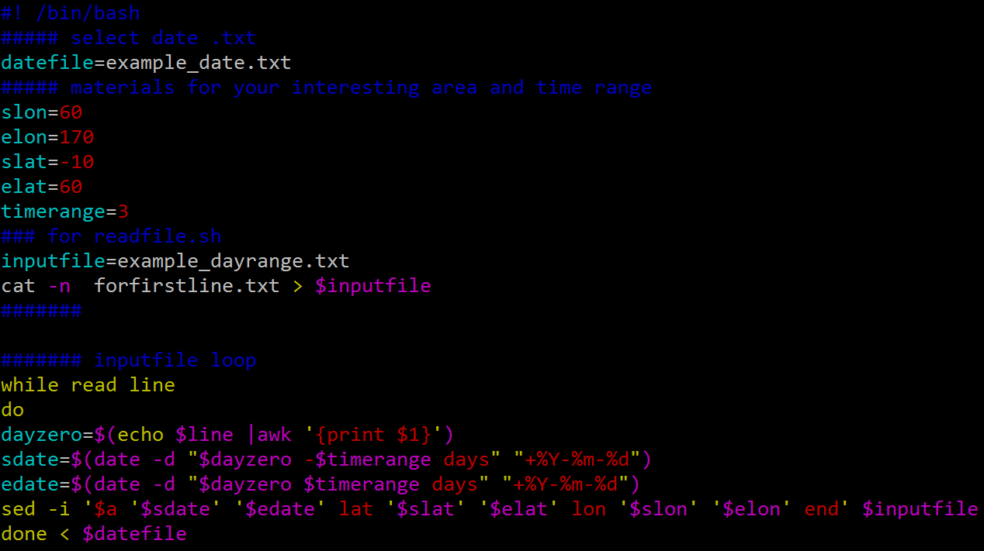
Input.sh
[datefile].txt
Longitude range
Latitude range
Time range (unit: day)
[inputfile].txt (命名)

Slide 20
ERA-interim -> ecreadfile_crossyear.sh TRMM 3B42 -> trmmreadfile_crossyear.sh
[inputfile].txt
for inputfile
1998-05-15 1998-05-21 lat -10 60 lon 60 170 end
1998-05-21 1998-05-27 lat -10 60 lon 60 170 end
1999-05-24 1999-05-30 lat -10 60 lon 60 170 end
2000-05-16 2000-05-22 lat -10 60 lon 60 170 end
2001-05-16 2001-05-22 lat -10 60 lon 60 170 end
2002-05-07 2002-05-13 lat -10 60 lon 60 170 end
2002-05-13 2002-05-19 lat -10 60 lon 60 170 end
2003-05-12 2003-05-18 lat -10 60 lon 60 170 end
2004-05-10 2004-05-16 lat -10 60 lon 60 170 end
2005-05-06 2005-05-12 lat -10 60 lon 60 170 end
readfile.sh
[inputfile].txt
Outfilepath (output files folder)
Time range (day)
Output var
Folderpath (shell script file path)
Renamefolder (symbolic links folder)
In:
[inputfile].txt
Out:
EC-U-1998-05-18.nc …
co-1.nc …
[outfilepath]/*nc
EC-U-1998-05-18.nc
EC-U-1998-05-24.nc
EC-U-1999-05-27.nc
EC-U-2000-05-19.nc
EC-U-2001-05-19.nc
EC-U-2002-05-10.nc
EC-U-2002-05-16.nc
EC-U-2003-05-15.nc
EC-U-2004-05-13.nc
EC-U-2005-05-9.nc
Date on file name : first day in this .nc file
[renamefolder]/*nc
co-1.nc
co-2.nc
co-3.nc
co-4.nc
co-5.nc
co-6.nc
co-7.nc
co-8.nc
co-9.nc
co-10.nc
Renamed symbolic links from [outfilepath]/*nc
For control file

Slide 21
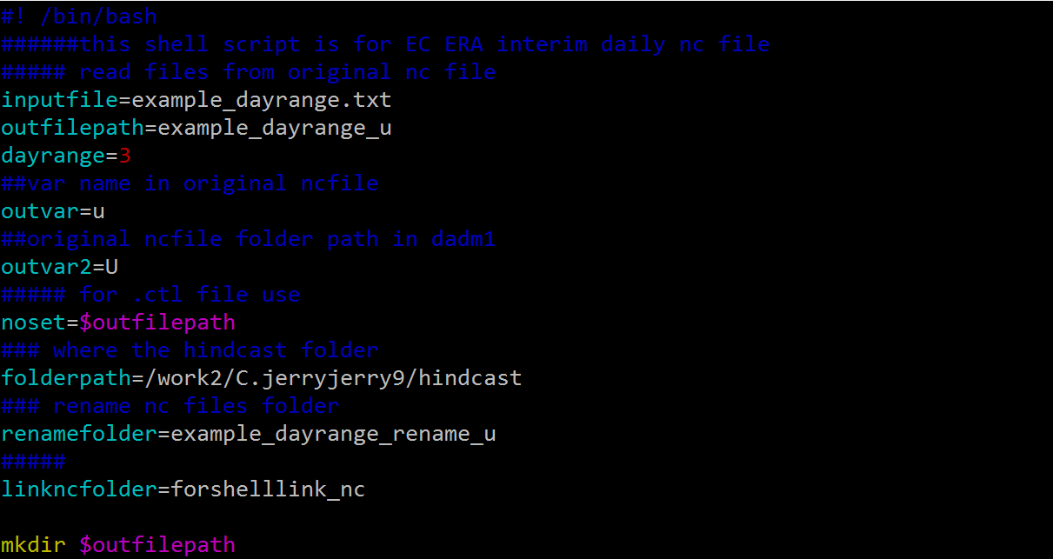
readfile.sh
[inputfile].txt
Outfilepath (output files folder)
Time range (day)
Output var
Folderpath (shell script file path)
Renamefolder (symbolic links folder)

Slide 22
EC ERA-interim -> setctl.sh, example_ec.ctl
TRMM 3B42 -> trmmsetctl.sh, emample_trmm.ctl
[renamefolder]/*nc
co-1.nc
co-2.nc
co-3.nc
co-4.nc
co-5.nc
co-6.nc
co-7.nc
co-8.nc
co-9.nc
co-10.nc
Setctl.sh
[ctl].ctl
Renamefolder
Time range (day)
Newvar (var name in ctl)
In:
co-1.nc …
Out:
[ctl].ctl
[ctl].ctl
All .nc files are on ensemble dimension
drawuvarrow.gs
drawtrmmuv.gs
-- drawing example

Slide 23
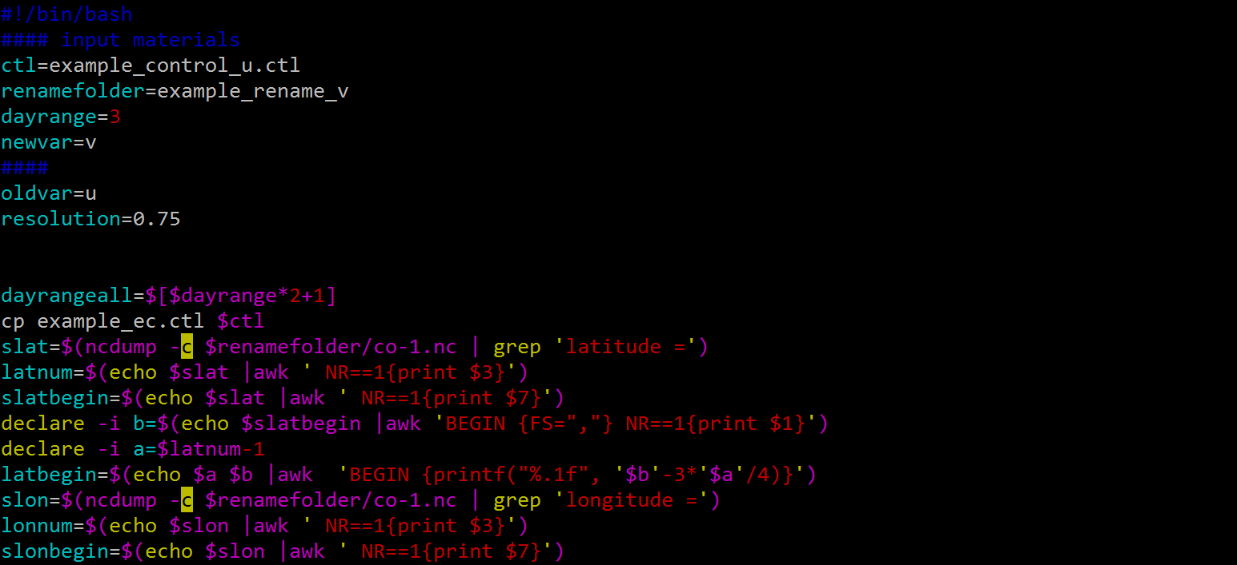
Setctl.sh
[ctl].ctl
Renamefolder
Time range (day)
Newvar (var name in ctl)

Slide 24
Data processing
CAPT-day-3
forgsinput.sh
h1-day3.ctl & h5-day3.ctl
hindcast-day3-out.gs
day3-out.ctl
Notes:
舉例而言 寒潮達標的第一天當作day 0 來看前後幾天,整個天氣的變化情形

Slide 25
Data processing
CAPT-day-3
Using day3-out.ctl GrADS draw figure
Date 們.txt
Modify
day3-out.ctl
forgsinput.sh
Date.txt for
hindcast-day3-out.gs
day3-out.gs
.dat files: CAPT output variables
Matlab or NCL draw figure
Notes:
舉例而言 寒潮達標的第一天當作day 0 來看前後幾天,整個天氣的變化情形

Slide 26
CAPT-day-3
[Datefile].txt
1998-05-18
1998-05-24
1999-05-27
2000-05-19
2001-05-19
2002-05-10
2002-05-16
2003-05-15
2004-05-13
2005-05-09
[inputfile].txt
1 for inputfile (delet this line!)
15May1998 21May1998 lat -10 60 lon 60 170 end
21May1998 27May1998 lat -10 60 lon 60 170 end
24May1999 30May1999 lat -10 60 lon 60 170 end
16May2000 22May2000 lat -10 60 lon 60 170 end
16May2001 22May2001 lat -10 60 lon 60 170 end
07May2002 13May2002 lat -10 60 lon 60 170 end
13May2002 19May2002 lat -10 60 lon 60 170 end
12May2003 18May2003 lat -10 60 lon 60 170 end
10May2004 16May2004 lat -10 60 lon 60 170 end
06May2005 12May2005 lat -10 60 lon 60 170 end
forgsinput.sh
[datefile].txt
Time range (unit: day)
[inputfile].txt (命名)
In:
[datefile].txt
forfirstline.txt
out:
[inputfile].txt

Slide 27
CAPT-day-3
[inputfile].txt
15May1998 21May1998 lat -10 60 lon 60 170 end
21May1998 27May1998 lat -10 60 lon 60 170 end
24May1999 30May1999 lat -10 60 lon 60 170 end
16May2000 22May2000 lat -10 60 lon 60 170 end
16May2001 22May2001 lat -10 60 lon 60 170 end
07May2002 13May2002 lat -10 60 lon 60 170 end
13May2002 19May2002 lat -10 60 lon 60 170 end
12May2003 18May2003 lat -10 60 lon 60 170 end
10May2004 16May2004 lat -10 60 lon 60 170 end
06May2005 12May2005 lat -10 60 lon 60 170 end
hindcast-day3-out.gs
[inputfile].txt
[day3-out].dat (命名)
Cases number
Add variables (if needed)
In:
[inputfile].txt
out:
[day3-out].dat
[day3-out].dat
Contain the variables you chose to put in .dat file
Modify day3-out.ctl
[day3-out].dat (change descriptor file)
Add variables (if needed)
Change time dimension depending on Cases number and time range
(e.g. 20 cases with 7days per case : 20*7=140)
Drawing !

Slide 28
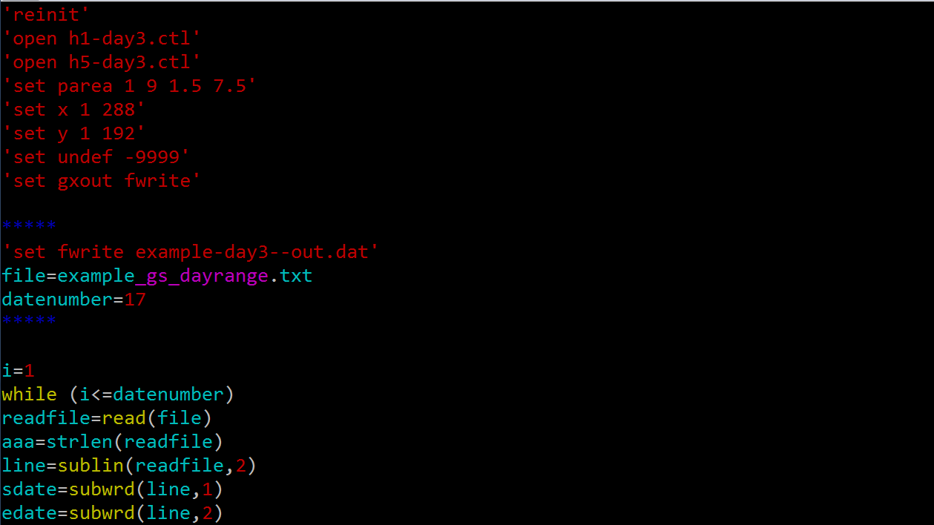
hindcast-day3-out.gs
[day3-out].dat (命名)
[inputfile].txt
Cases number

Slide 29
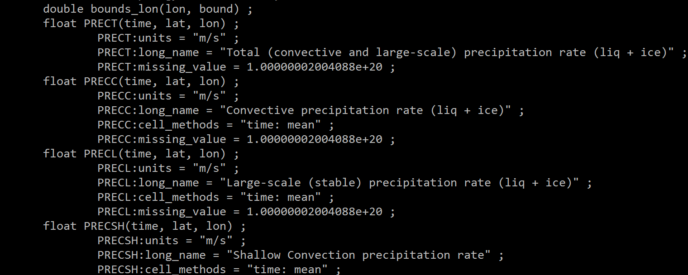
Add variables (hindcast-day3-out.gs) – three steps
1. Check daily_var_h1.txt & daily_var_h5.txt
Daily_var_h5.txt

Slide 30
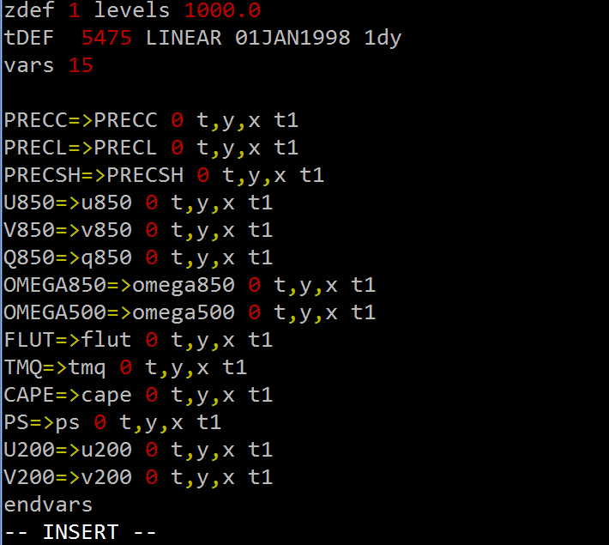
Add variables (hindcast-day3-out.gs) – three steps
2. Modify the h1-day3.ctl & h5-day3.ctl
h5-day3.ctl
+1

Slide 31
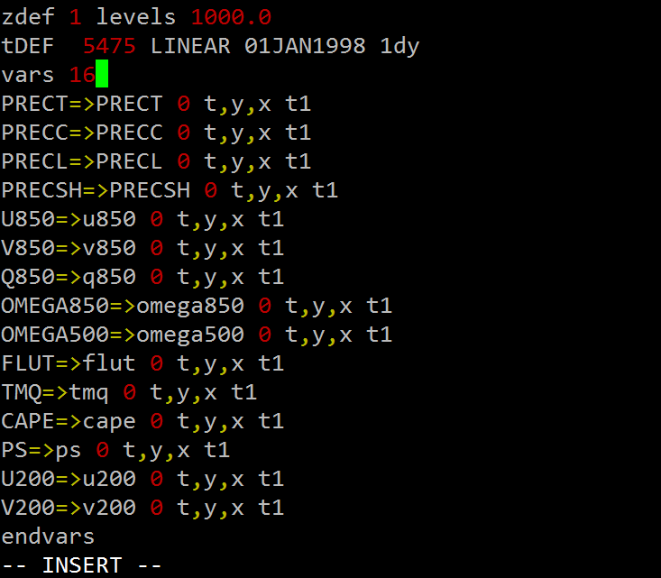
Add variables (hindcast-day3-out.gs) – three steps
2. Modify the h1-day3.ctl & h5-day3.ctl
h5-day3.ctl

Slide 32
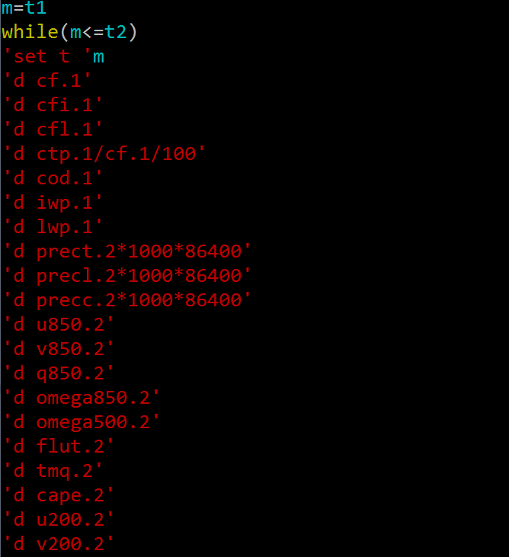
Add variables (hindcast-day3-out.gs) – three steps
3. Modify the hindcast-day3-out.gs
hindcast-day3-out.gs

Slide 33
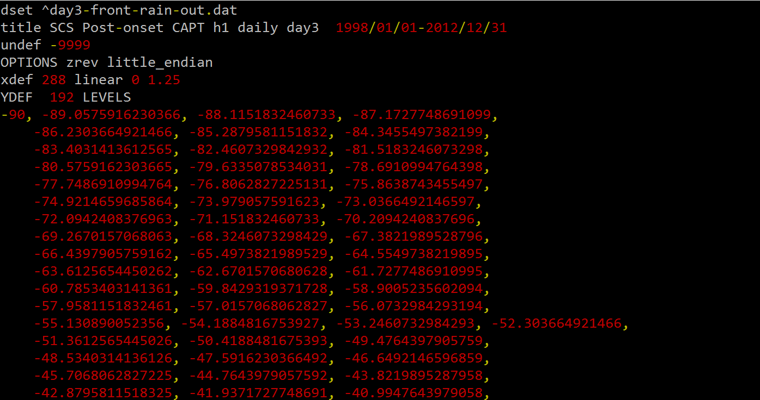
Modify day3-out.ctl
[day3-out].dat (change descriptor file)
Add variables (if needed)
Change time dimension depending on Cases number and time range
(e.g. 20 cases with 7days per case : 20*7=140)

Slide 34
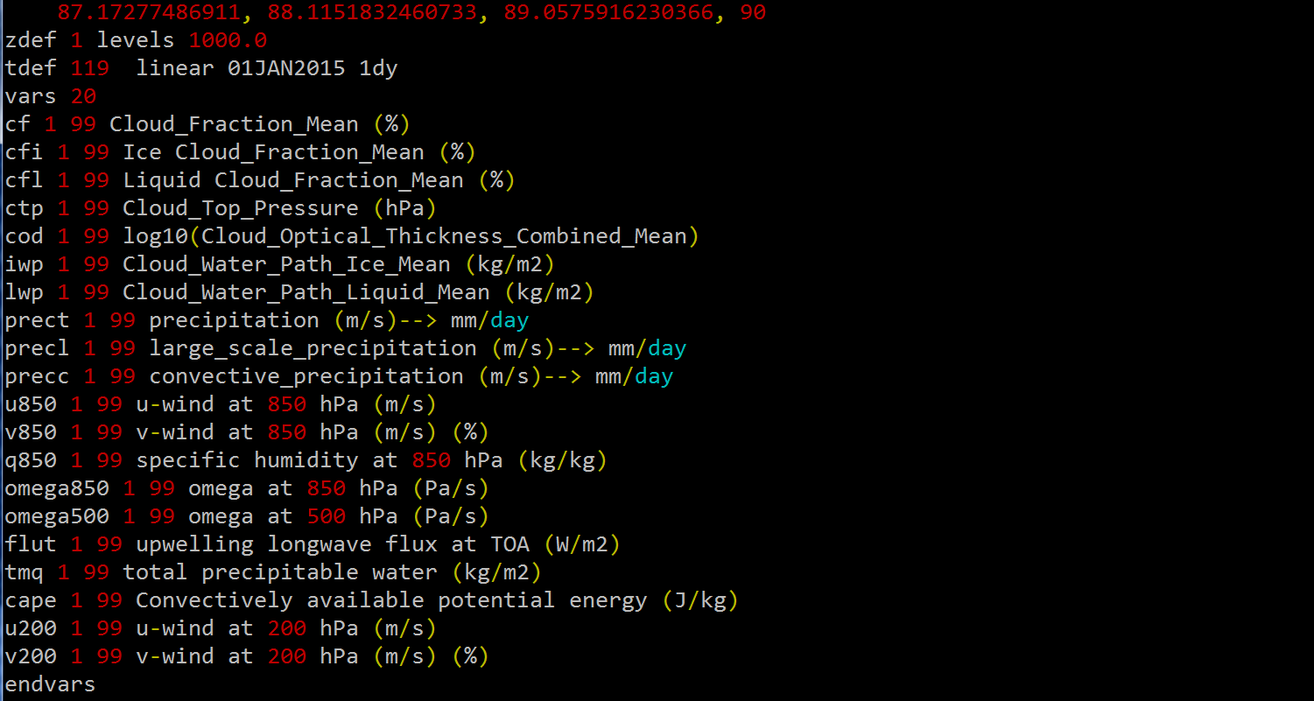
Modify day3-out.ctl
[day3-out].dat (change descriptor file)
Add variables (if needed)
Change time dimension depending on Cases number and time range

Slide 35
Reference
https://pcmdi.llnl.gov/projects/capt/index.html CAPT main page
Ma, H.-Y., S. Xie, J. S. Boyle, S. A. Klein, and Y. Zhang, 2013: Metrics and diagnostics for precipitation-related processes in climate model short-range hindcasts. J. Clim., 26, 1516-1534, doi: 10.1175/JCLI-D-12-00235.1.
https://code.mpimet.mpg.de/projects/cdo/ cdo home page
https://code.mpimet.mpg.de/projects/cdo/embedded/cdo_eca.pdf
正規表示法

Slide 36
END
Homework: composite maps of cold surge and strong NW

Slide 37


Slide 38


Slide 39
Cold surge day 0 composite
Notes:
These metrics and diagnostics should provide an objective measure to quantify how fast hindcast errors approach climate errors and to judge the improvement of model simulations from new parameterizations. This is under the premise that improvement of these errors in the hindcast mode is very relevant to the improvement of these errors in the climate mode. Indeed, climate models with better forecast skills tend to perform well in the climate simulations (Hurrell et al. 2010; Martin et al. 2010) since many of the major systematic biases in the climate simulations are associated with ‘‘fast processes’’ (e.g., clouds and precipitation). Furthermore, a standard set of metrics and diagnostics for climate model forecasts is particularly needed because more and more major modeling centers are adapting the concept of ‘‘seamless prediction’’ across weather and climate time scales in developing their future weather forecast models and climate models (Palmer et al. 2008).

